Slide 1




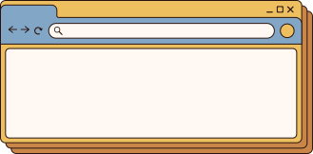

Spotify Clone Project
Presented by Anukool Sharma

Slide 2



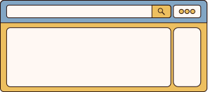
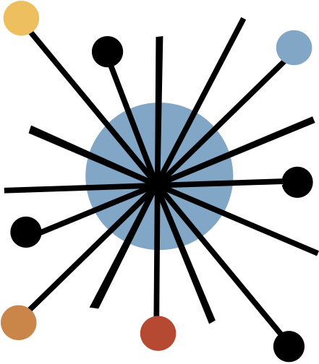

Introduction
This project aims to create a Spotify clone, which provide a user-friendly interface for music streaming, allowing users to select playlists, play songs, and navigate through playback controls.

Slide 3
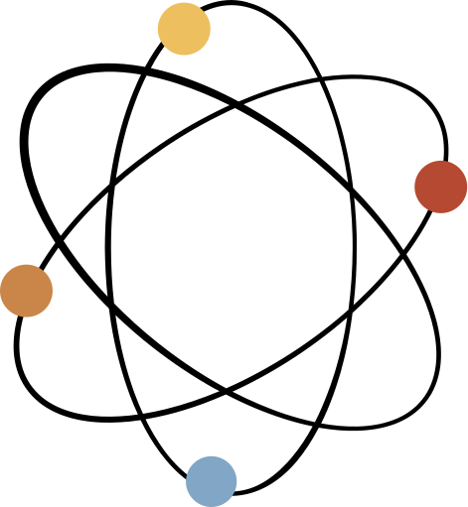

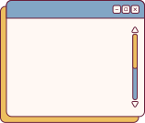


Project Overview
Each feature contributes to a seamless user experience, allowing users to easily navigate and enjoy their music.
Main Features:
Playlist display
Song selection
Playback controls
Registration and login
functionality

Slide 4
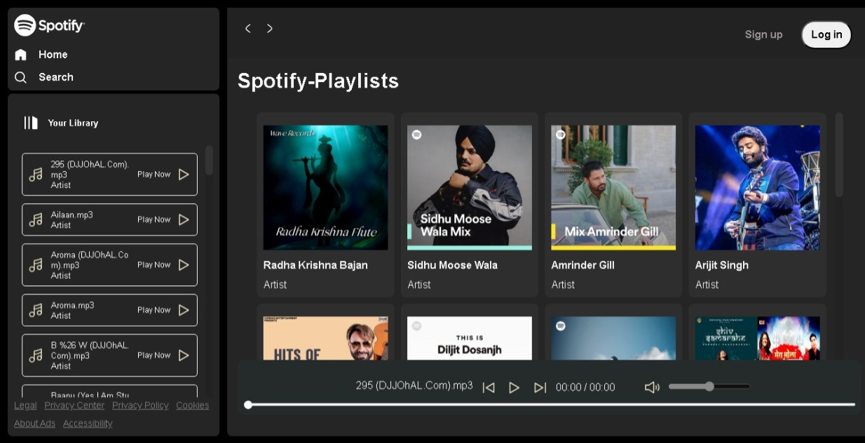

Slide 5

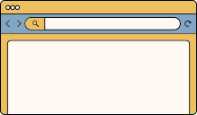
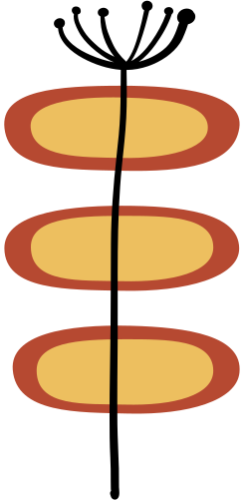
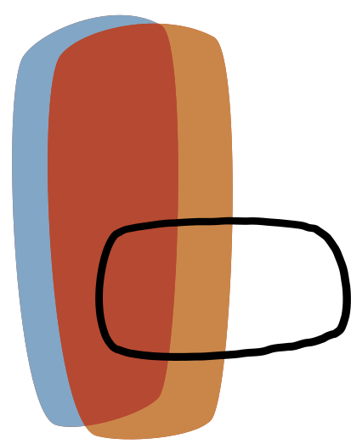

Playlist Selection
User selection : Users can select playlists from a range of options, updating the song list dynamically.
Playlist Choices: Providing a wide range of playlist user can select according their musical tastes.

Slide 6
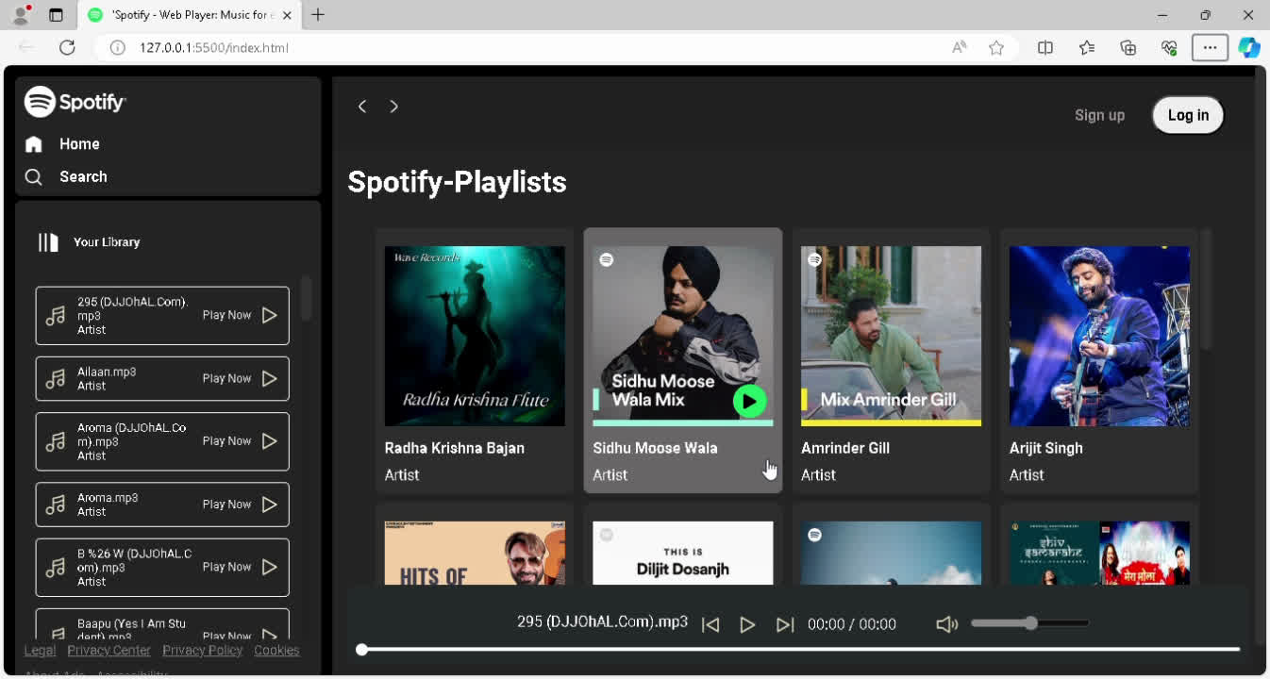

Slide 7
Playback Controls
Playback controls allow users to manage their listening experience, with play, pause, next, and previous buttons.
User can interact with these controls to navigate through their music seamlessly.

Slide 8
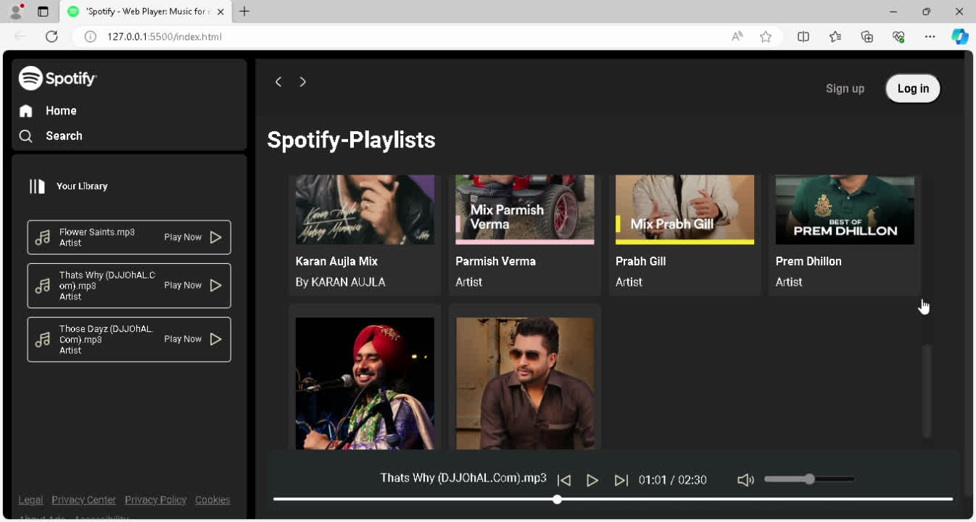

Slide 9
Registration Page
The registration page allows new users to sign up for an account, providing required fields for username, email and password , and also registered through mobile number.

Slide 10
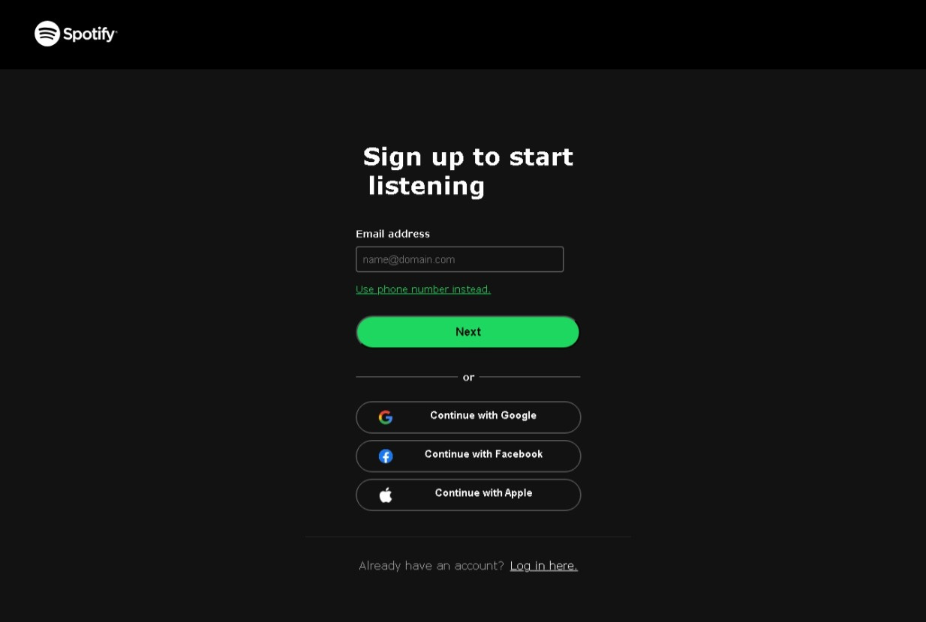

Slide 11
Login Page
The login page allows registered users to access their accounts, providing input fields for username and password.
Authentication measures are implemented to ensure a secure and user friendly login experience.

Slide 12
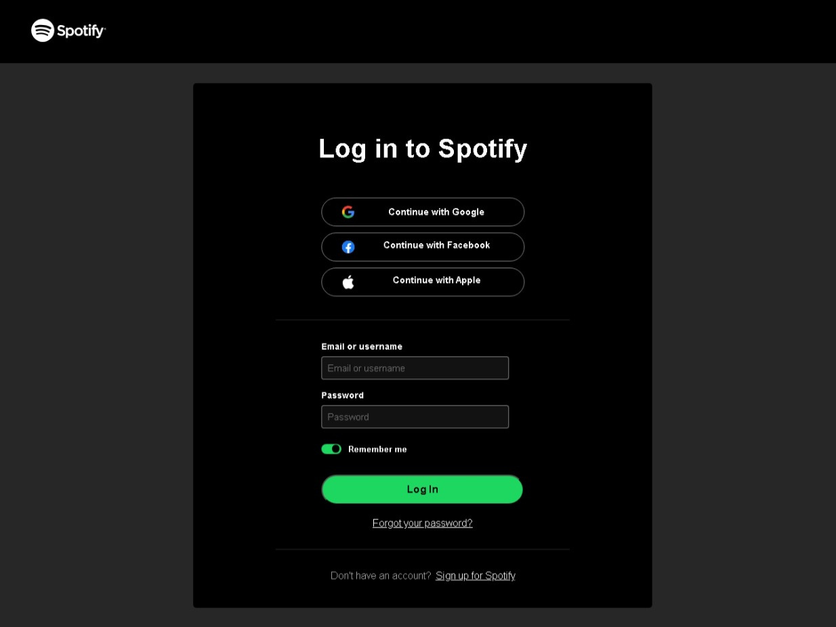

Slide 13
Responsive Design
Mention that the project include hamburger functionality for mobile devices, enhancing usability, and ensuring a seamless experience across different screen size with its fully responsive design.

Slide 14
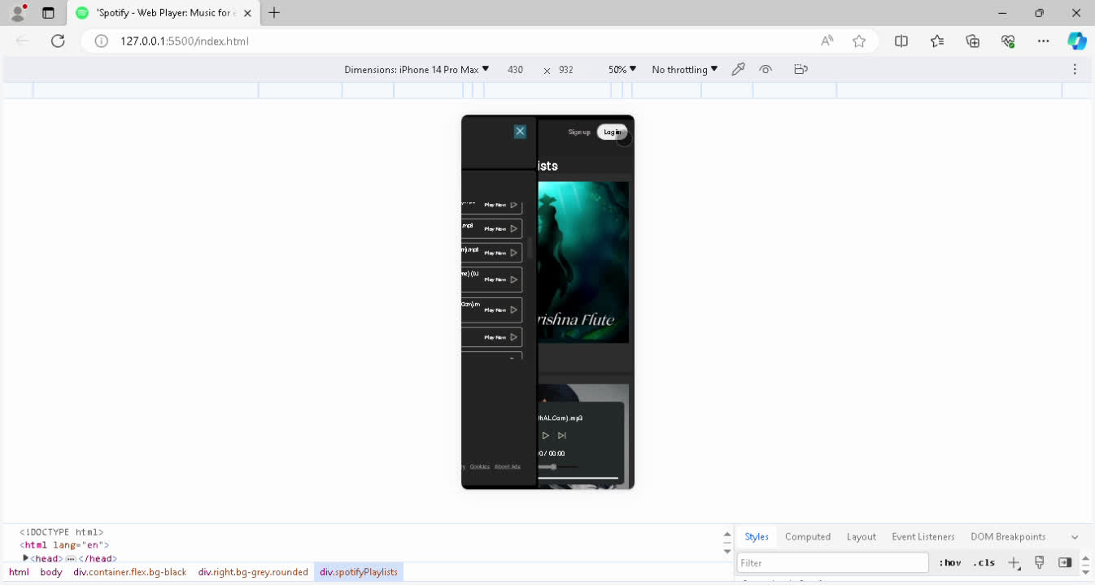

Slide 15


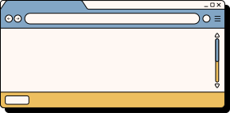







Conclusion
This project successfully adds some of Spotify’s key features providing a user-friendly music streaming experience.
Future plans include adding additional features, such as search functionality, database fetching and storing functionality , generating lyrics, and social sharing options.

Slide 16
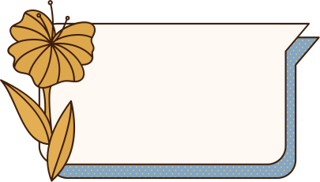
Thank
You

